Slide 1
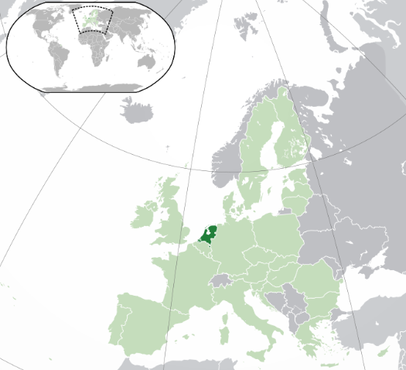
The safe system approach in the Netherlands: adoption, implementation and lessons learned
Dr. Letty Aarts
Parachute webinar
26 September 2017

Slide 2
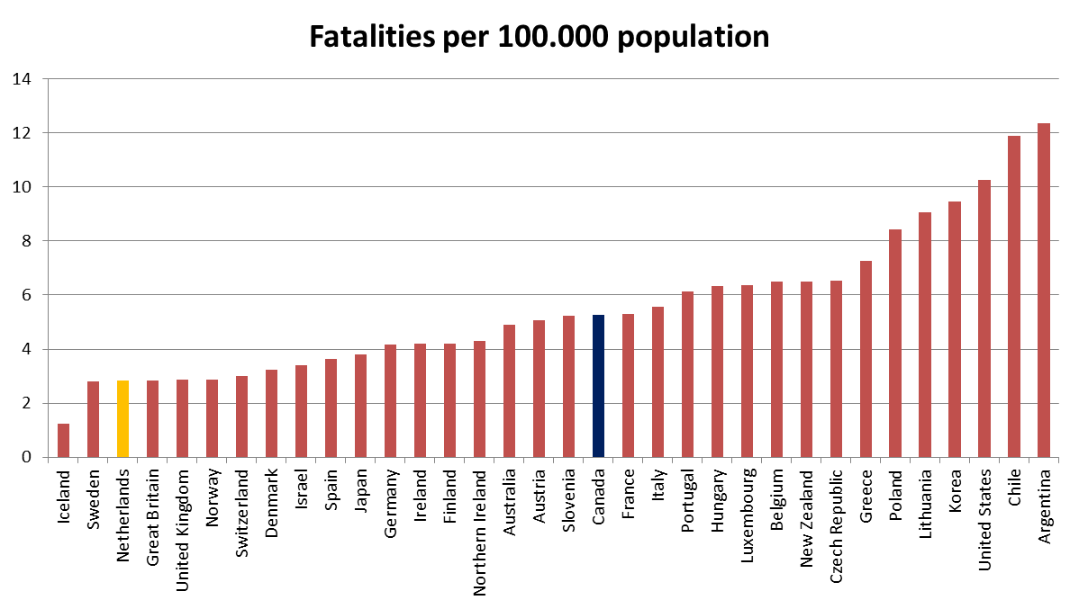
International ranking
WHO ranking of 180 states (2015)
The Netherlands: rank 8
Canada: rank 29
Source: IRTAD/OECD (2014)

Slide 3
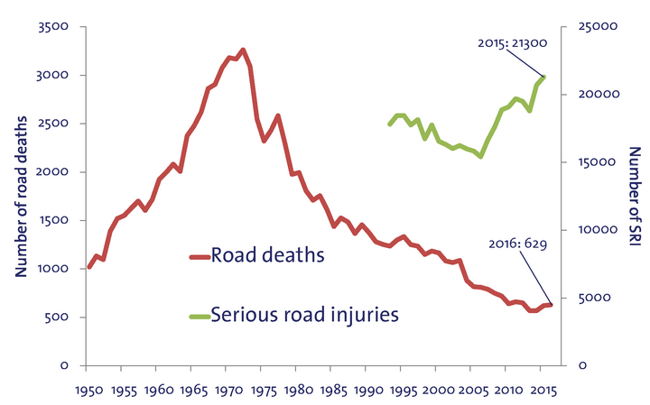
Road safety figures

Slide 4
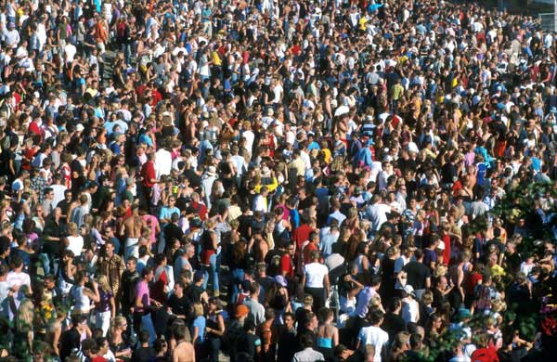
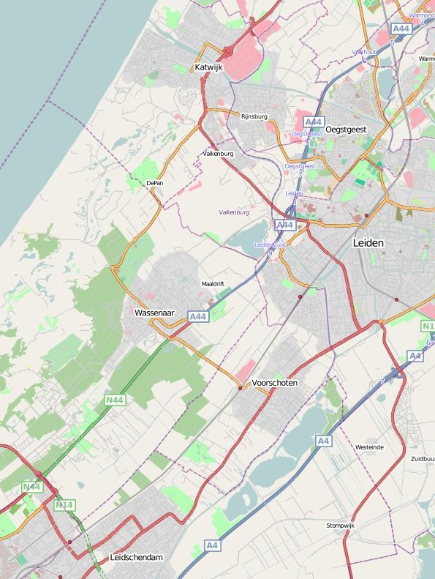
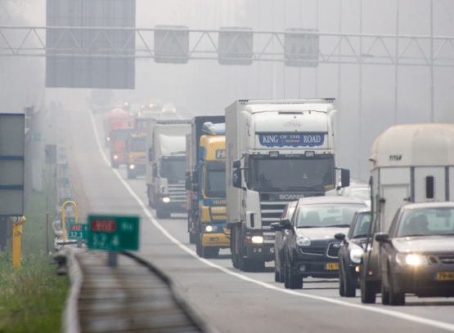
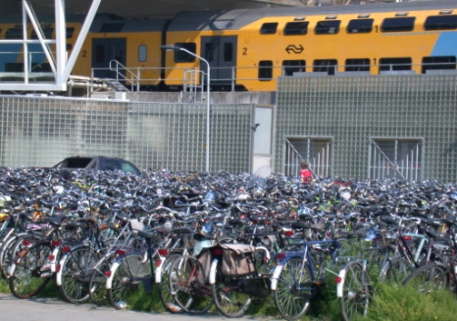
Our traffic context
…dense road network
Dense population (>400 people/km²)…
…large traffic volumes
(> 2,000 mv/h on motorways)…
…many vulnerable road users (1.3 bicycles/inhabitant)…

Slide 5
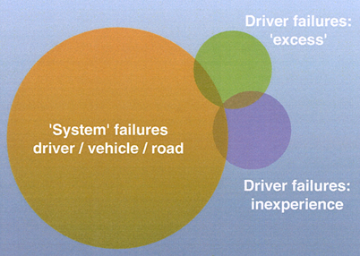
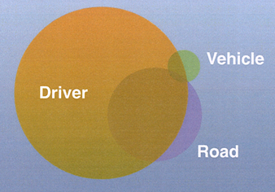
Historical development of safety visions
1900-1950
Individual blame culture:
- Bad luck (1900 →)
- Accident-prone drivers (1920 →)
1950-1985
Risks in man, road, vehicle:
- Single cause approach (1950 →)
- Multiple cause approach (1960 →)
1985 – now
Integral safe system approach
- Vision Zero
- Sustainable Safety

Slide 6
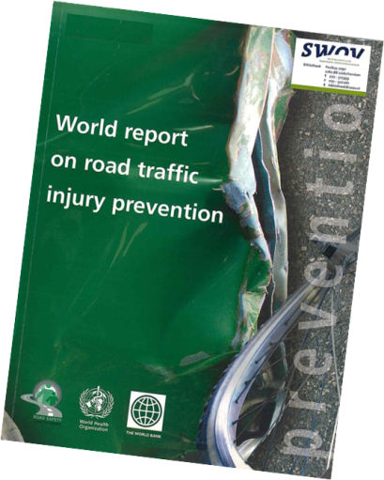
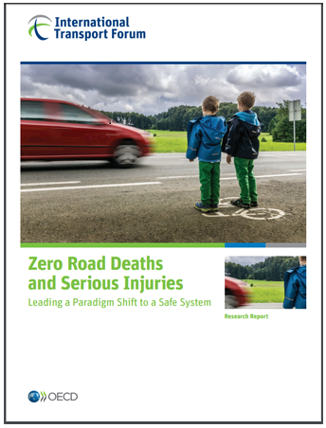
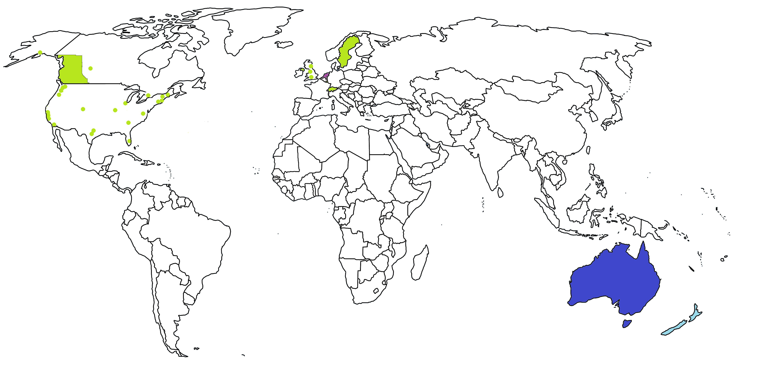
Safe Traffic System and Vision Zero developments
Vision zero
Sustainable safety
Safe System approach Australia
Safe System approach New Zealand

Slide 7
Sustainable Safety

Slide 8
Sustainable Safety history
1992
Introduction of the Sustainable Safety vision
1995
Start of demonstration projects
-2002
Start-up programme
2005/2006
Launch of the
first advanced version
2017
Preparations for second advanced version

Slide 9
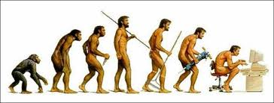
Some words on the title
‘Sustainable’ as in UN Brundtland-report (1987) on sustainable development
“…a development that meets the needs of the present without compromising the ability of future generations to meet their own needs.”

Slide 10
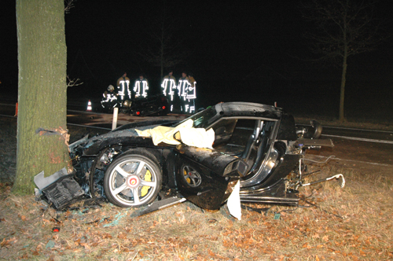
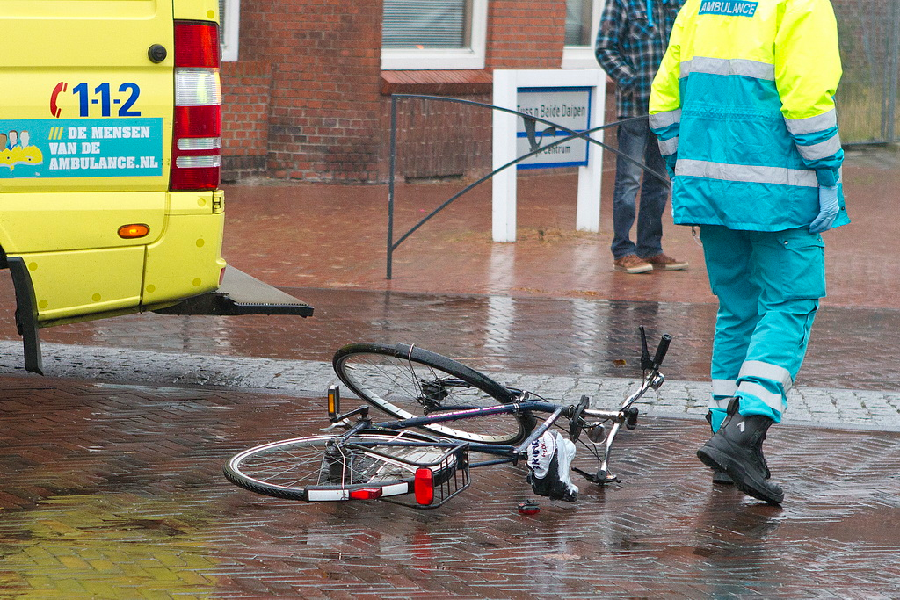
Core of Sustainable Safety - goals
Preventing crashes
Reducing probability of serious injury

Slide 11
Core of Sustainable Safety – human measure
Humans are vulnerable
Humans are fallible
Humans are tempted

Slide 12
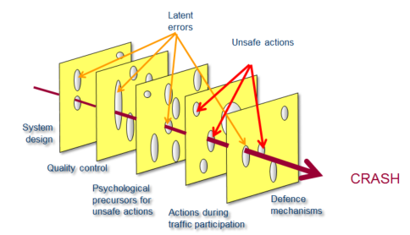
Core of Sustainable Safety – proactive approach
Intervene as early in chain of events as possible
Prevent system failures
Make unsafe actions less dependent from individual choices

Slide 13
How to deal with the ‘human measure’?
INFRASTRUCTURE
Design fits to the human capabilities and limitations
VEHICLE
Support the driving task
Provide physical protection
ROAD USER
Is well informed and trained
Behaviour is being checked were needed
Engineering
Education
Enforcement
Notes:
And it is then important to realize that although people make errors, that is not the same as that road users are to blame for crashes.
The road system should ideally be designed to expect and accomodate human error.
Design the road system to expect and accommodate human error, because it is inevitable that road users make mistakes and sometimes violate the law (and crashes occur)
tailor environment (road, vehicle) to human characteristics
prepare road user for traffic tasks (training, education)
beware: not all training is beneficial -> e.g. skid training !
In a crash, interaction between vehicle – roadway – human body must be managed so that serious injury likelihood is minimized, if not eliminated

Slide 14
Safety principles
Functionality of roads
Physical
aspects of humans
Psychological
aspects of humans
Homogeneity of masses, speed and driving directions
Predictability of road course and road user behaviour by recognizable road design
Forgivingness
of the road environment and of road users
State awareness of road users

Slide 15
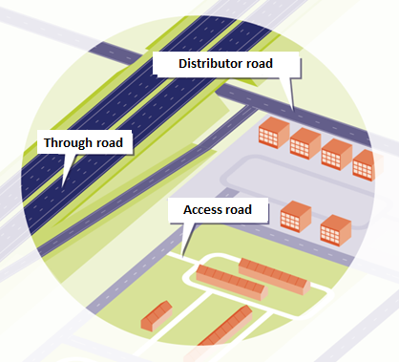
Functionality of roads
Road category | Flow | Exchange
Through road | all | -
Distributor road | road | intersection
Access road | - | all
Notes:
3 categories of road: Category 1) roads with through function for rapid movement of through traffic
Category 2 - Distributor roads for the distribution and collection of traffic between different districts and resd. areas
Category 3 - roads with an access function providing access to property whilst ensuring the safety of the street as a meeting place

Slide 16
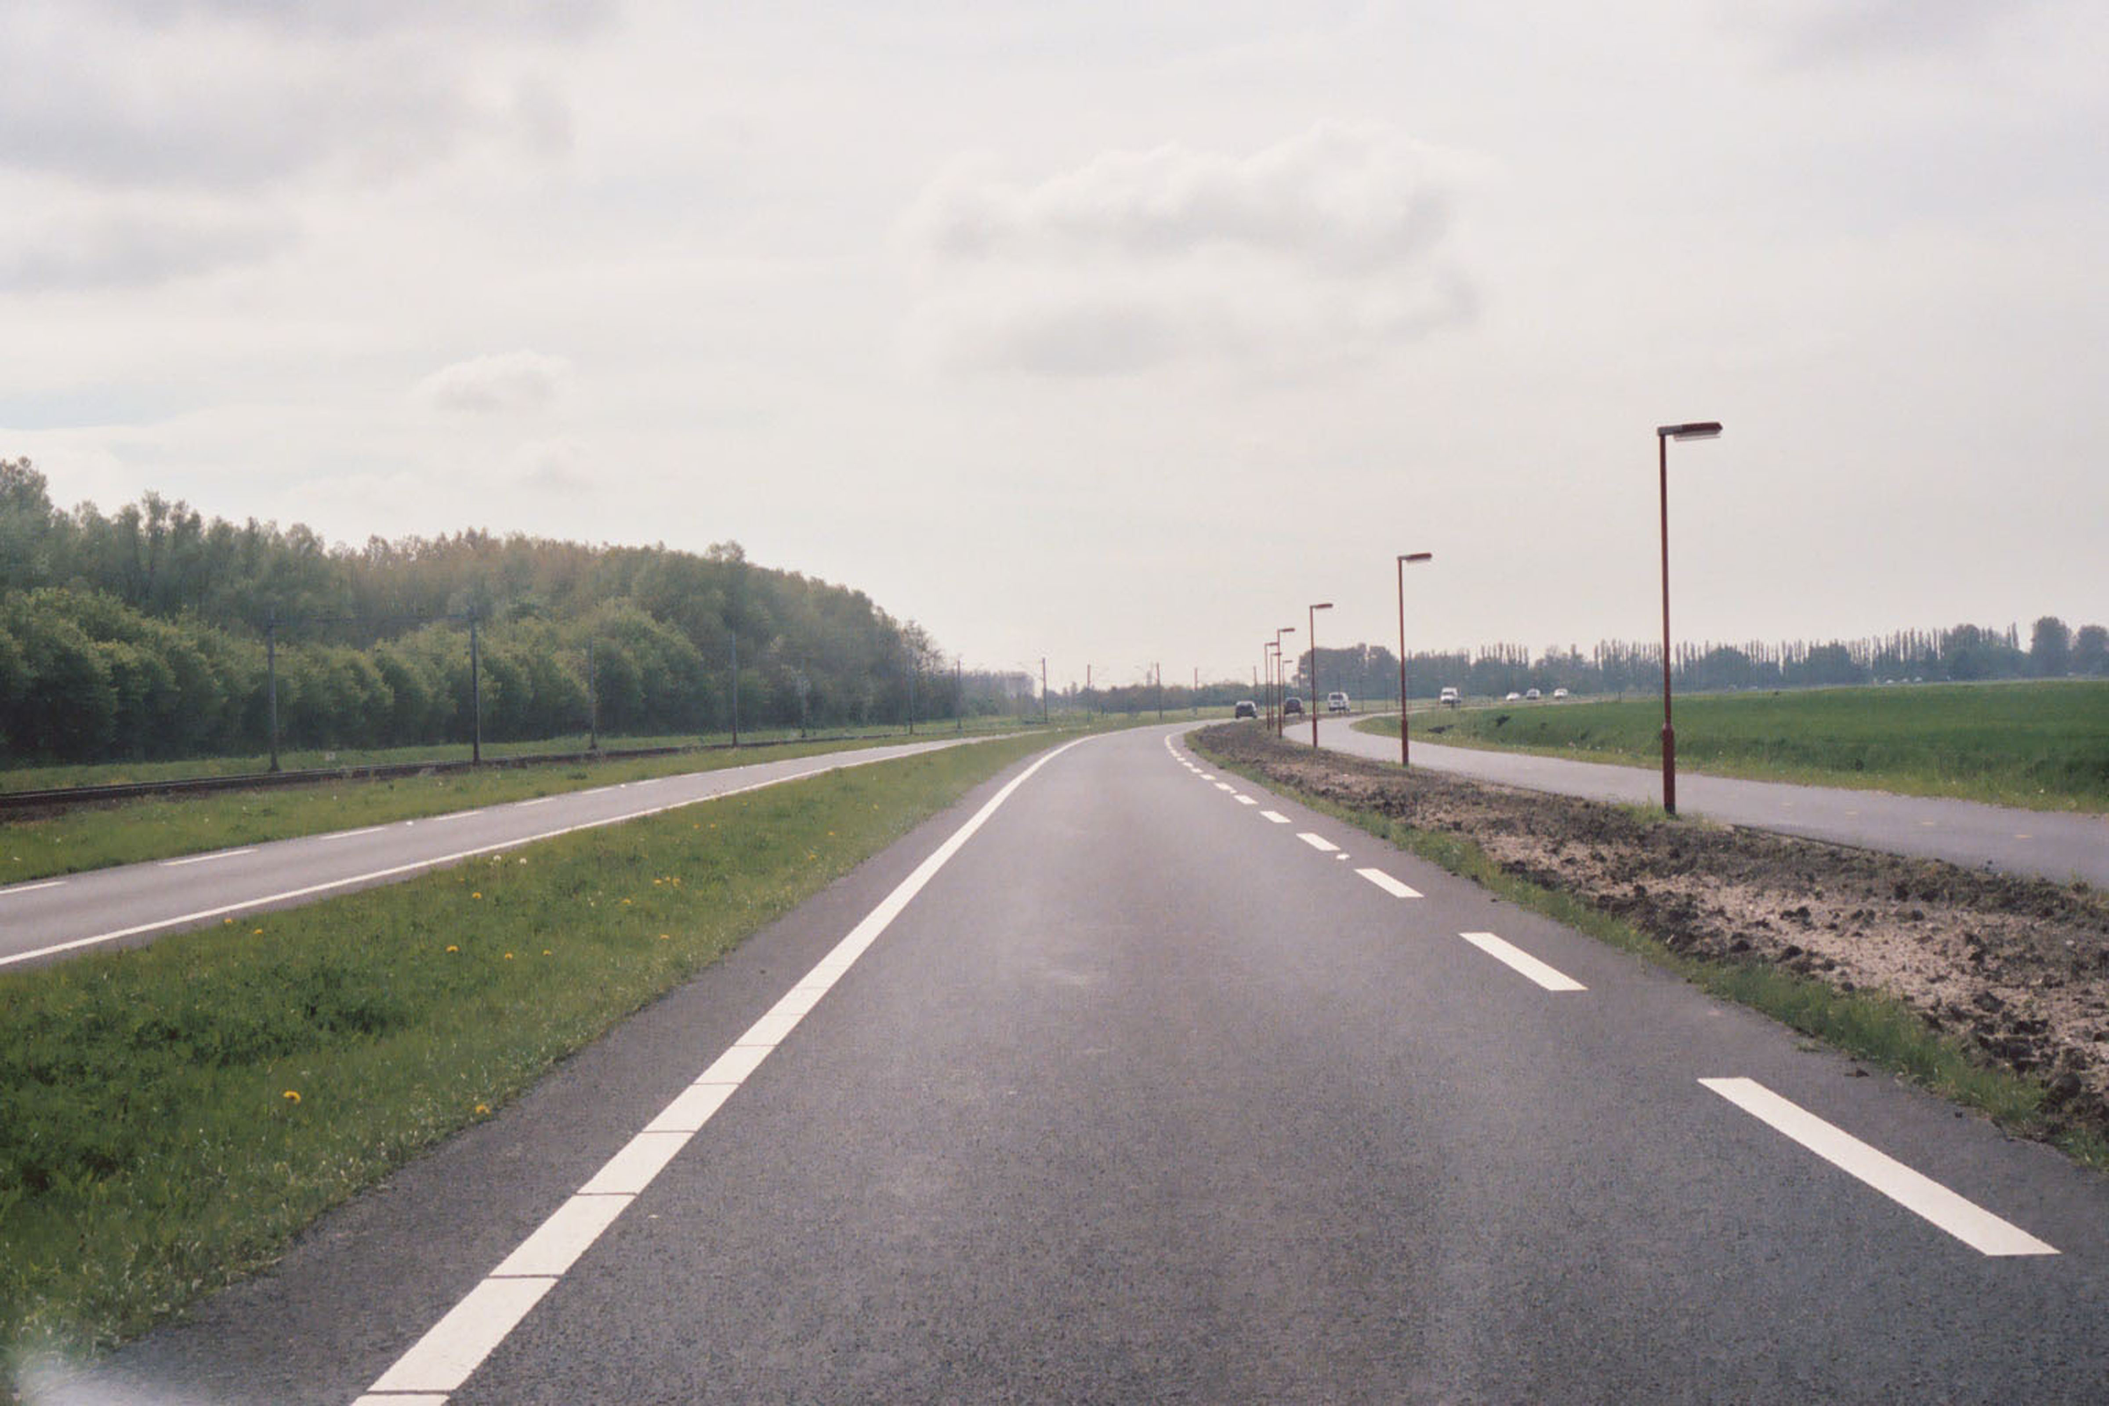
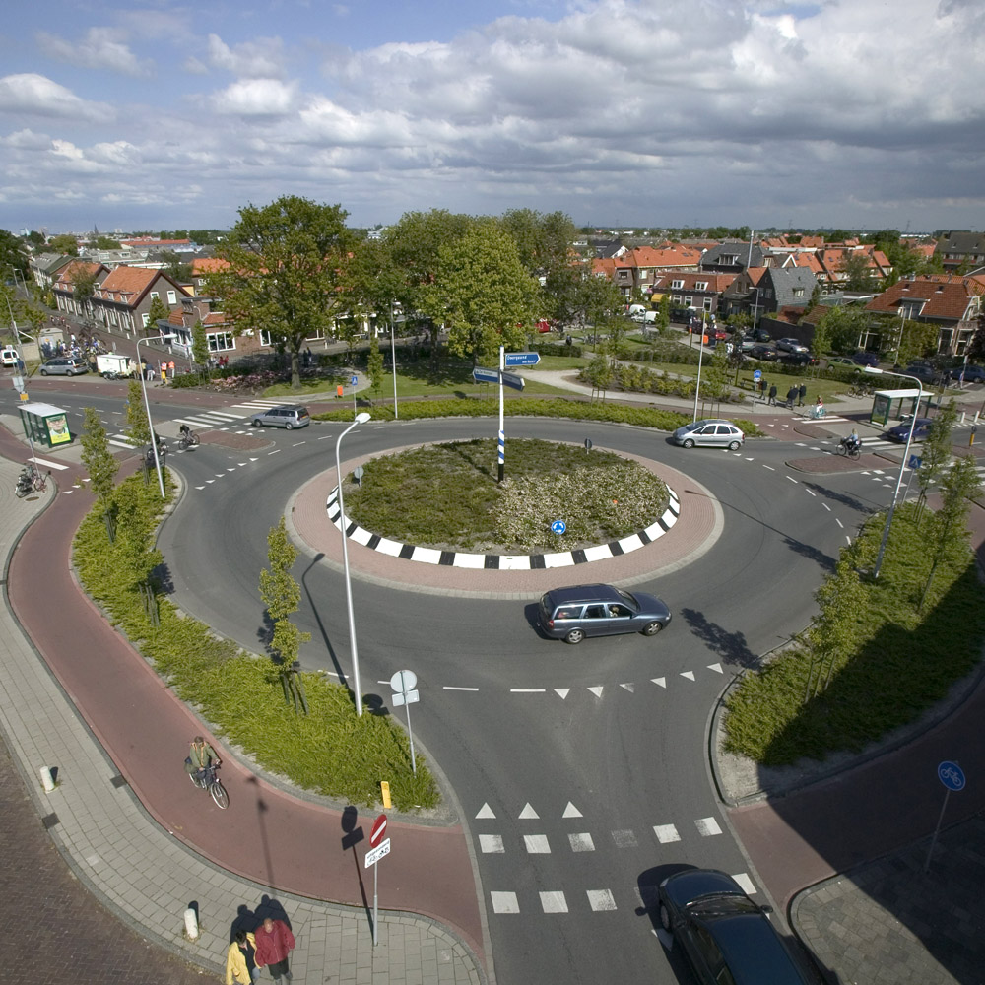
Homogeneity in mass, speed and driving direction
Prevention of conflicts at high speed (flow)
Separate driving lanes for differences in mass or speed
Opposite driving directions: physical separation
Conflicts unavoidable (exchange)? Reduce speed!
Lower speed limit
Speed reduction at intersections

Slide 17
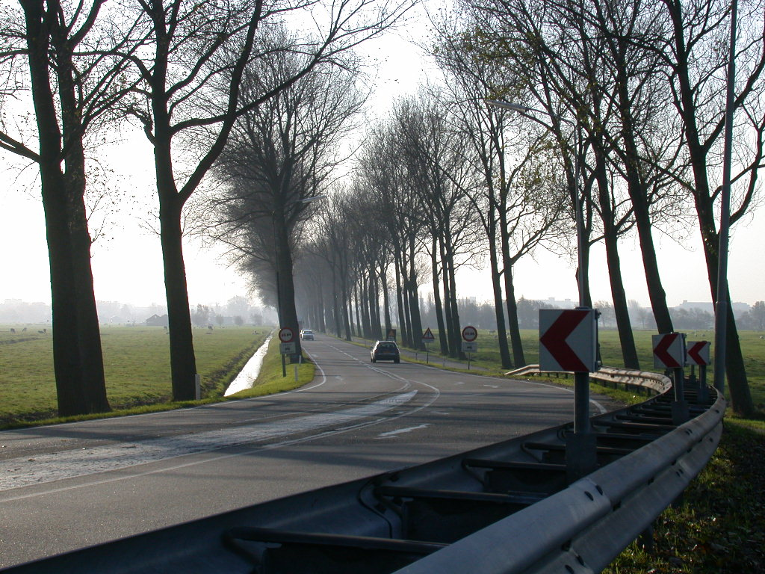
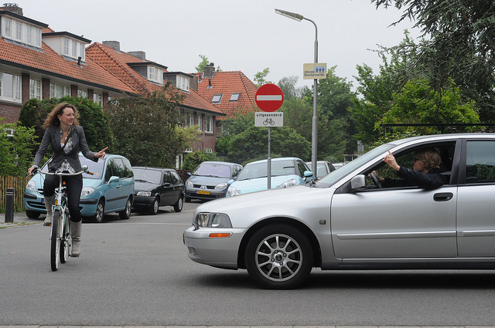
Forgivingness: physical and social
Physical forgivingness:
Matted shoulders
Obstacle-free zones
Shielded obstacles
Social forgivingness:
Anticipating way of traffic participation
Giving space to other road users
Particularly directed at less capable road users
Notes:
Aim to mitigate the injury effects of crashes
Forgiving roadsides
Crash friendly obstacles
Road edge markings
Shoulder drop off treatments
etc

Slide 18
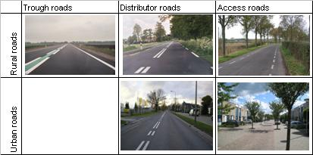
Predictability of road layout and traffic behaviour
Reduce uncertainty and probability of failure:
Recognizable situations: consistency in road design
Predictable road course: continuity in road design
‘Essential Recognisability Characteristics ‘(ERC):
100 km/h
80 km/h
60/80 km/h
50 km/h
30 /15km/h
Notes:
Aim to prevent uncertainty in use:
Avoid necessity to search for destination/directions
Ensure all road categories are recognisable (self explaining)
Limit the number of designs/road types and ensure uniformity in design

Slide 19
State awareness of the road user
Being aware of ones own
Competences
Situational task capacibility
Notes:
Ability of the road user to assess task capability for the driving task
Make road users aware of own capabilities and limitations
Teach road users to recognise dangerous situations and to manage risk
Become part of the solution, not the problem

Slide 20
Implementation and results

Slide 21
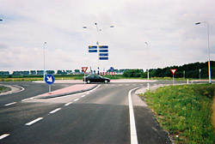
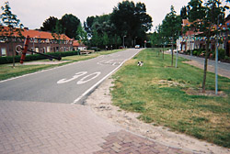
Demonstration projects
Aim: implementation experience at local level
Main lessons
Cooperation between parties (road authorities + police)
Transparency about tasks + budgets
Communication (public support)

Slide 22
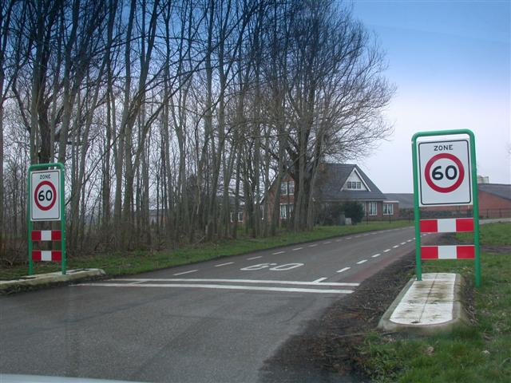
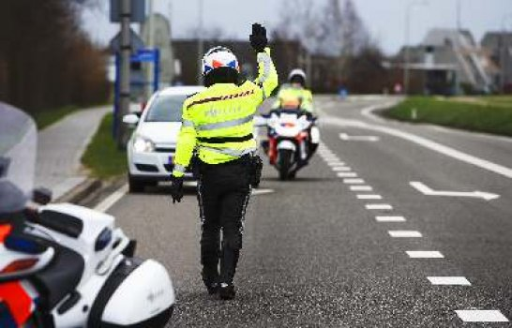
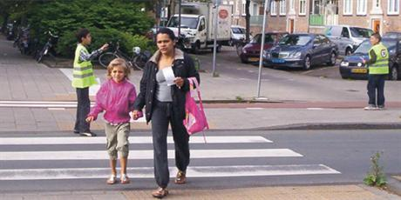
Startup programme
Covenant (1997)
central government, provincial, local authorities
24 agreements on implementation and financing
Implemented measures:
Categorisation of roads (ca. 100%)
30 km/h zones: 30 000 km out of 55 000 km
60 km/h zones: 12 500 km out of 25 000 km
(Roundabouts: from 1000 to 3000)
Essential Recognisability Characteristics (40-75% on rural roads)
Increase in traffic enforcement (regional teams)
Permanent traffic education toolkit: traffic education programmes for all age groups

Slide 23
Total road safety effects
1600 to 1700 lives saved in 1998-2007
Decrease in risk was stronger than period before (5.8% versus 2.6% per year)
Benefits about 4x costs of measures
However: less effective for serious road injuries
Notes:
6% less deaths and hospitalizations

Slide 24
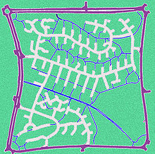
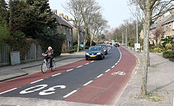
Lessons learned in practice
Low cost implementation: phasing solution but not the final idea!
Start in the right order:
Good network structure
Well designed and attractive through roads
Safe and credible lower order roads
Attention for:
Communication with the public
All elements of the road system
Evaluation
Appropriate timing
Linkage to other policy domains to get support (integral approach)
Notes:
Main issues about measures in the advanced version:
Continuation of infrastructural measures
Elaboration of education and enforcement as part of Sustainable Safety
New possibilities through ITS
Policy issues:
Build on the successes of the past (first phase of Sustainable Safety)
More attention for systematic evaluation of effects
Produce higher quality with similar amounts of effort
More tuning, integration, and cooperation between fields

Slide 25
New developments

Slide 26
Elements for an update
Actual problems
Expected developments
Desired future
Goals
Vision
= how to reach the desired future
Context and conditions
Solutions

Slide 27
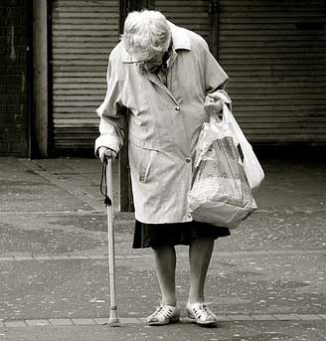
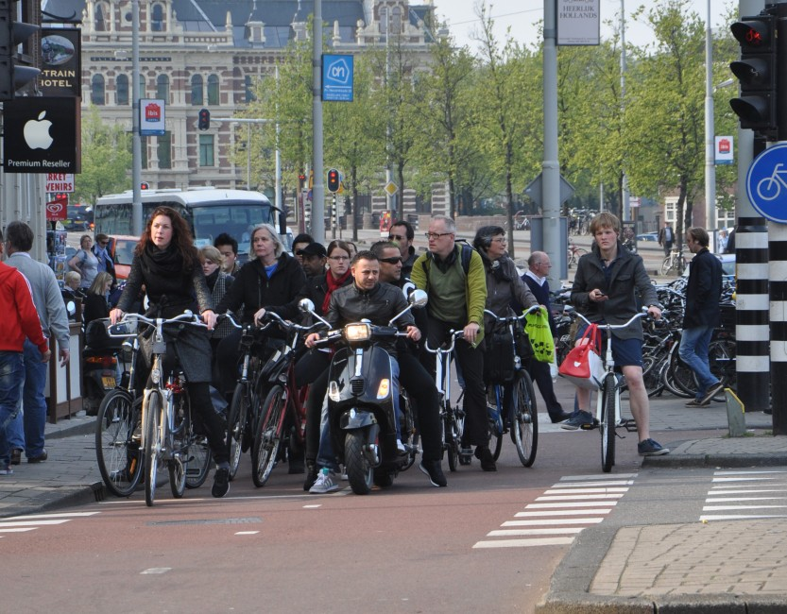
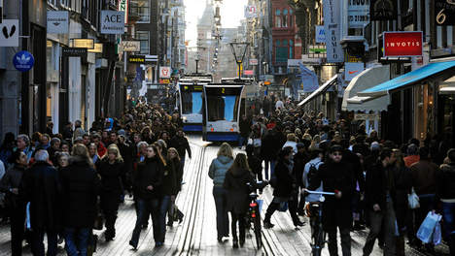
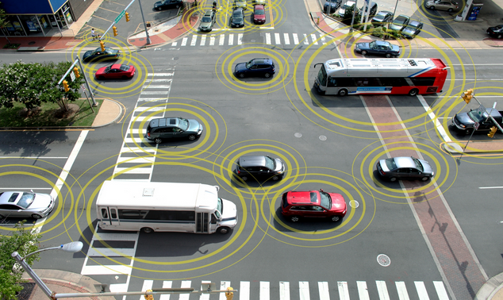
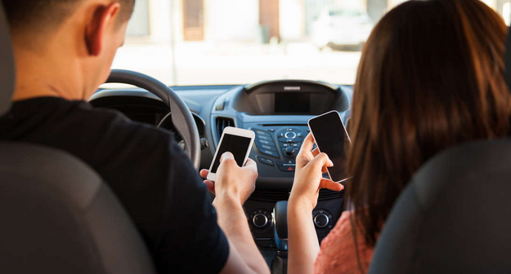
Trends & developments
Demographic developments
Mobility patterns
Urbanisation
Global warming
Economic development
Information and communication technology

Slide 28
Desired future
Context and conditions:
Maintain the status quo
Only prevent damage to others
Inherently safe traffic for all (but realistic) = maximal safety
Enjoy the achievements
Coming to a rest
Economic activity
Care for children and the eldery
Development
Exploration of capabilities
Safety Accessibility Freedom

Slide 29
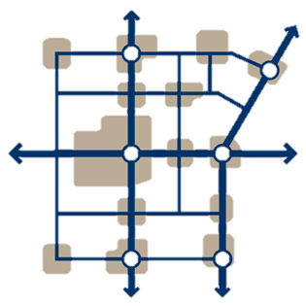
Elements for the new update
Goals:
Reduce largest risks
Prevent serious crashes
Limit the long-lasting consequences
The human measure
The traffic system
Road functionality
Responsibility
Learning and innovation
Physical compatibility
Psychologic compatibility
Operationalisations
Safety principles
Measures

Slide 30
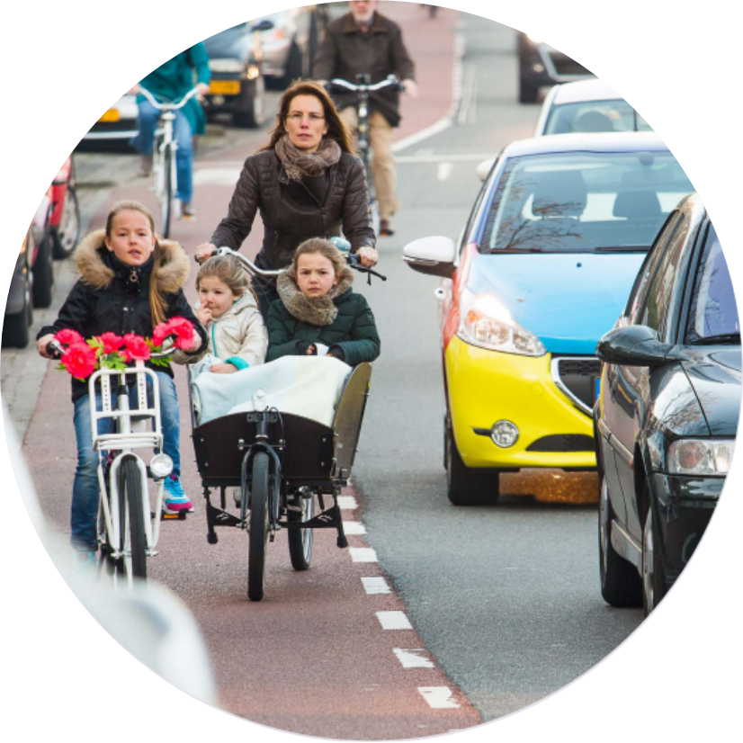
To conclude
First steps towards Safe System Approach: paradigm shift possible!
Success depends on understanding the vision behind it:
Don’t wait for crashes to occur
Real understanding of ‘the human measure’
Start with the problem, then find sustainable solutions
Connect road safety to other policy domains
Join us towards a safe road traffic system
Share your ideas and experiences
Cooperate in taking first or further steps…

Slide 31
Thank you for your attention!
Questions?
Dr. Letty Aarts
I: www.swov.nl
E: Letty.Aarts@SWOV.NL
T: +31 70 317 33 79

